Slide 1

THE
BUDGET
BLUEPRINT

Slide 2

TOOLS USED
Understanding and Analyzing how the government allocates resources across various sectors over time, and how these allocations reflect national priorities, economic goals, and fiscal management.
PURPOSE
DASHBOARD
HYPOTHESIS

Slide 3
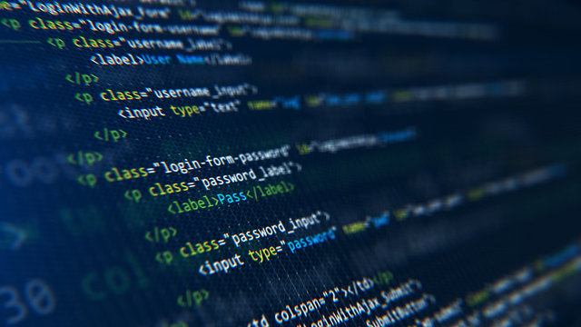
TOOLS USED
Excel
SQL
PYTHON
POWER BI
PURPOSE
DASHBOARD
HYPOTHESIS

Slide 4

Understanding and Analyzing how the government allocates resources across various sectors over time, and how these allocations reflect national priorities, economic goals, and fiscal management.
SQL
PYTHON
POWER BI
Sectoral Prioritization
Sector Analysis
Sector Trend Analysis
Fiscal Deficit Trend
The Indian government spends the largest portion of its budget on sectors related to ____________________________
TOOLS USED
PURPOSE
DASHBOARD
HYPOTHESIS

Slide 5
Understanding and Analyzing how the government allocates resources across various sectors over time, and how these allocations reflect national priorities, economic goals, and fiscal management.
SQL
PYTHON
POWER BI
Sectoral Prioritization
Budget Trend Analysis
Sector Trend Analysis
Fiscal deficit Trend
The Indian government spends the largest portion of its budget on sectors related to ____________________________
TOOLS USED
PURPOSE
DASHBOARD
Subsidy
Interest
Defence
IT and Telecom
HYPOTHESIS

Slide 6




TOOLS USED

Slide 7

EXCEL

Slide 8
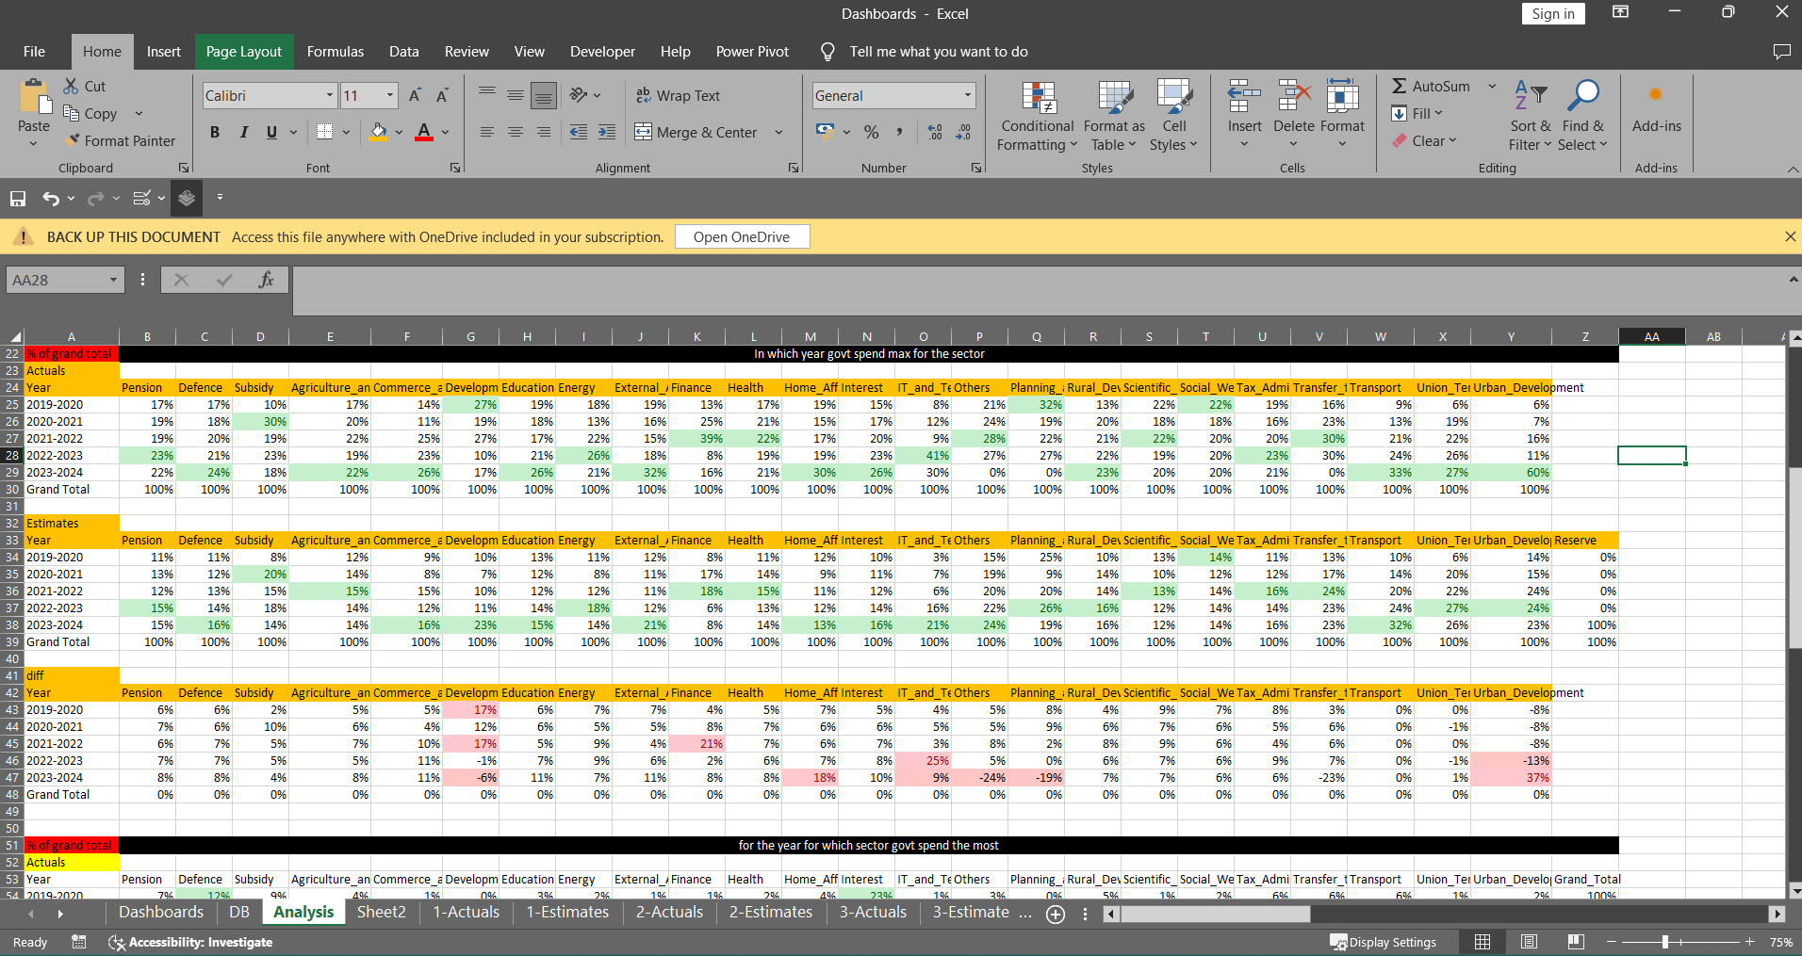
EXCEL

Slide 9

SQL

Slide 10
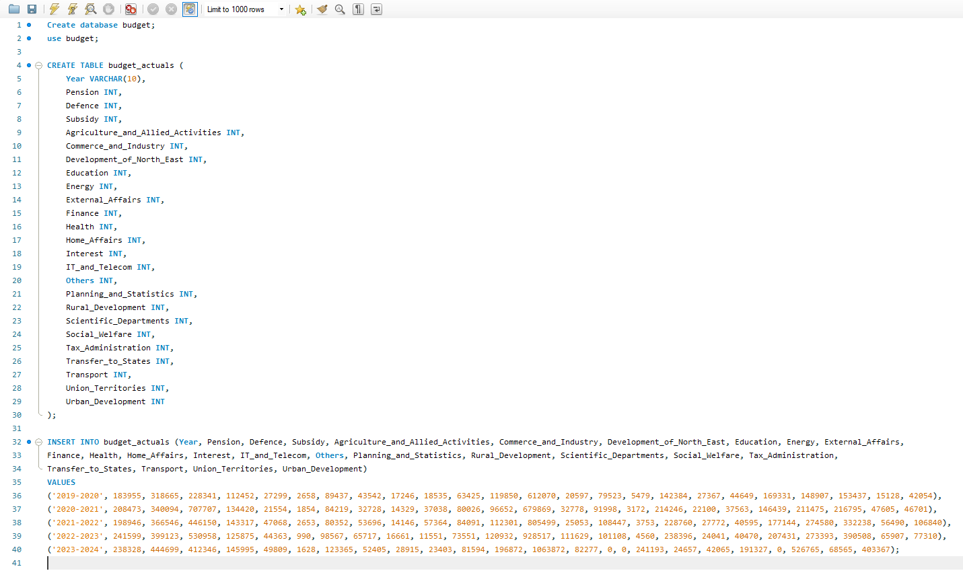
SQL

Slide 11
PYTHON

Slide 12
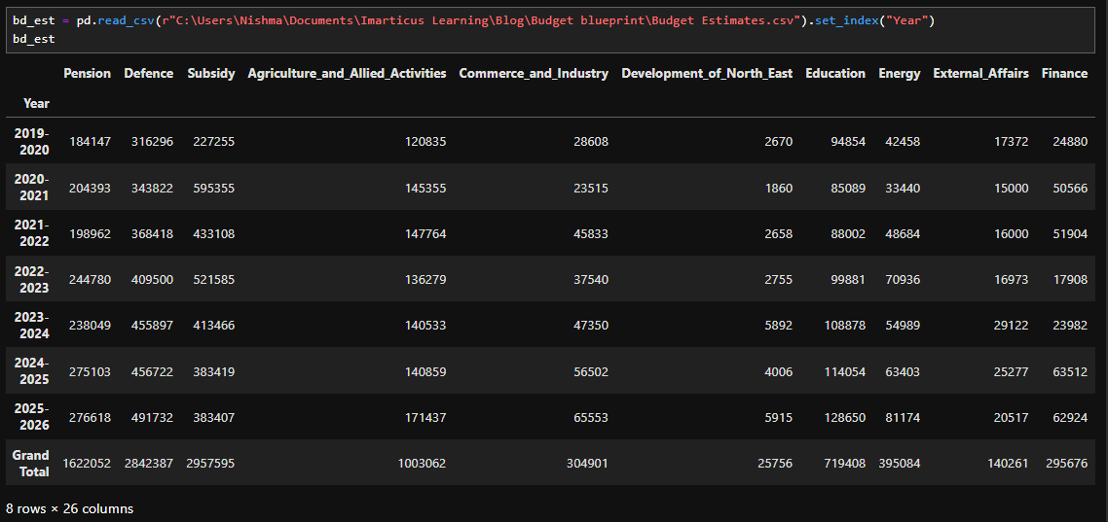
PYTHON

Slide 13
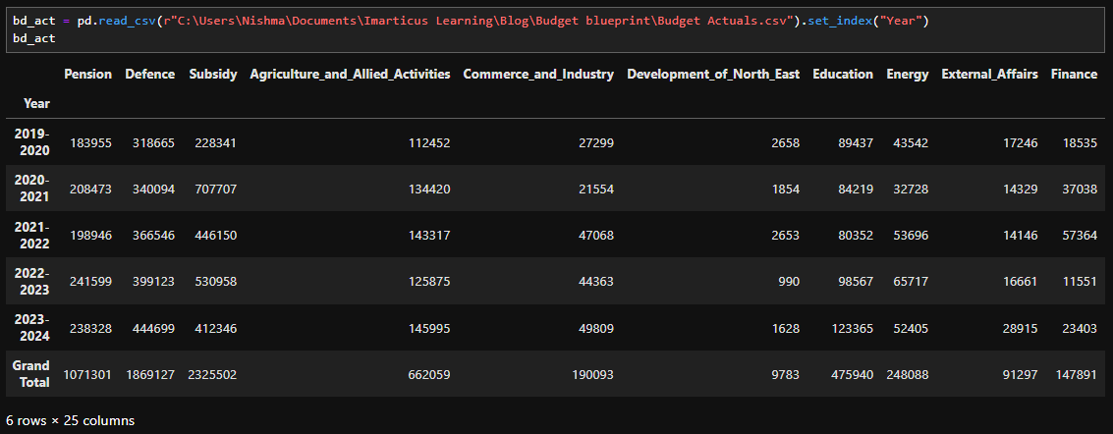

Slide 14
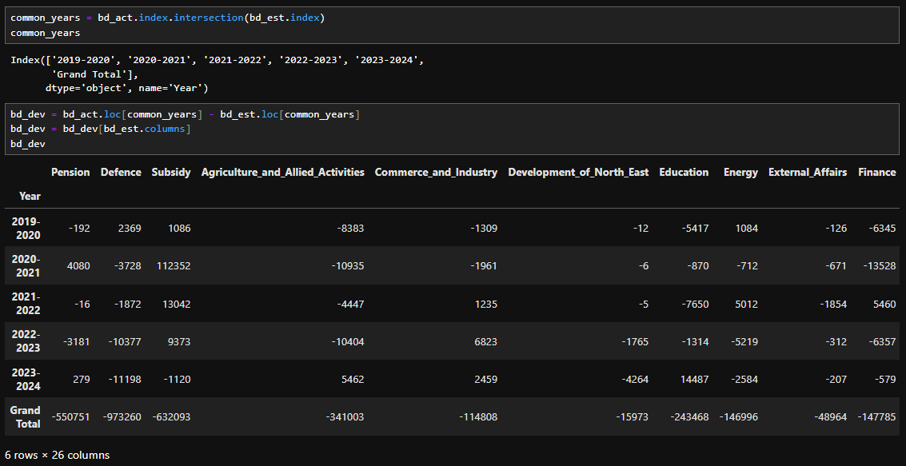
PYTHON

Slide 15
POWER BI

Slide 16
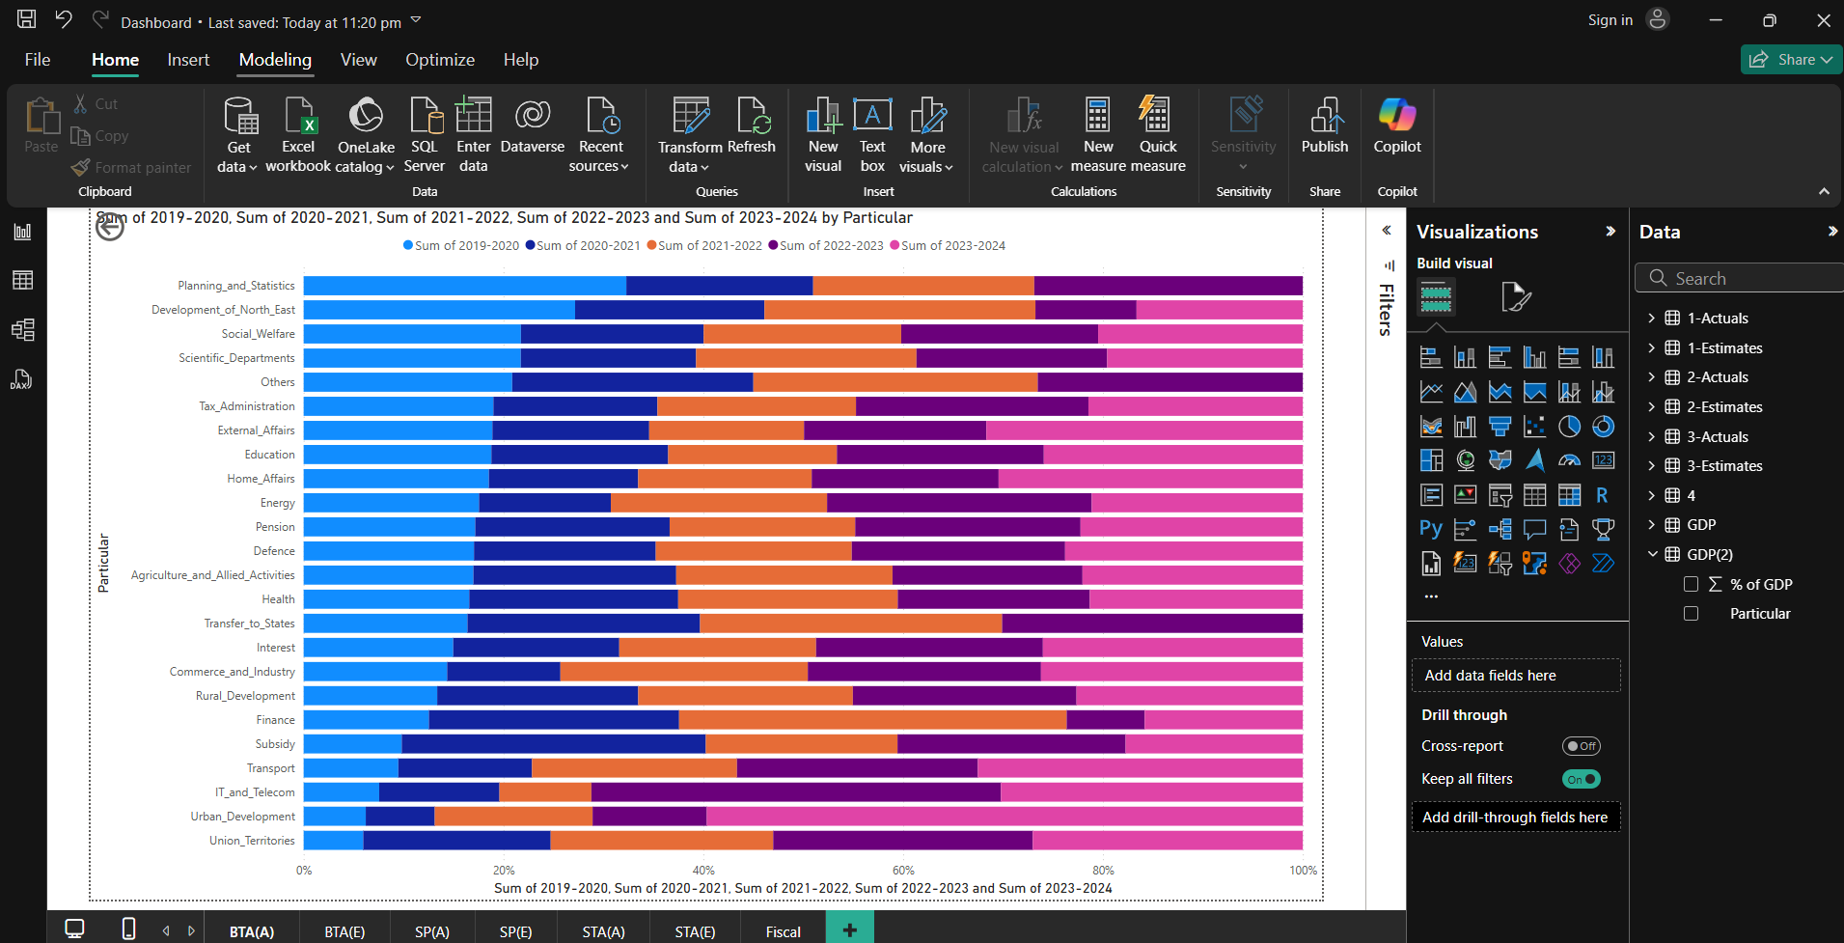
POWER BI

Slide 17
DASHBOARD

Slide 18

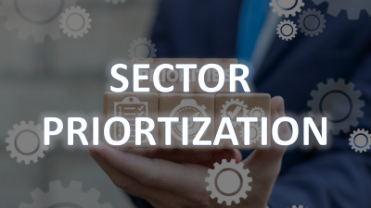


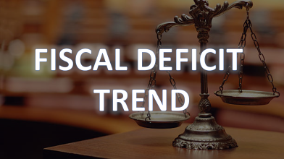


DASHBOARD

Slide 19
SECTOR TREND ANALYSIS

Slide 20
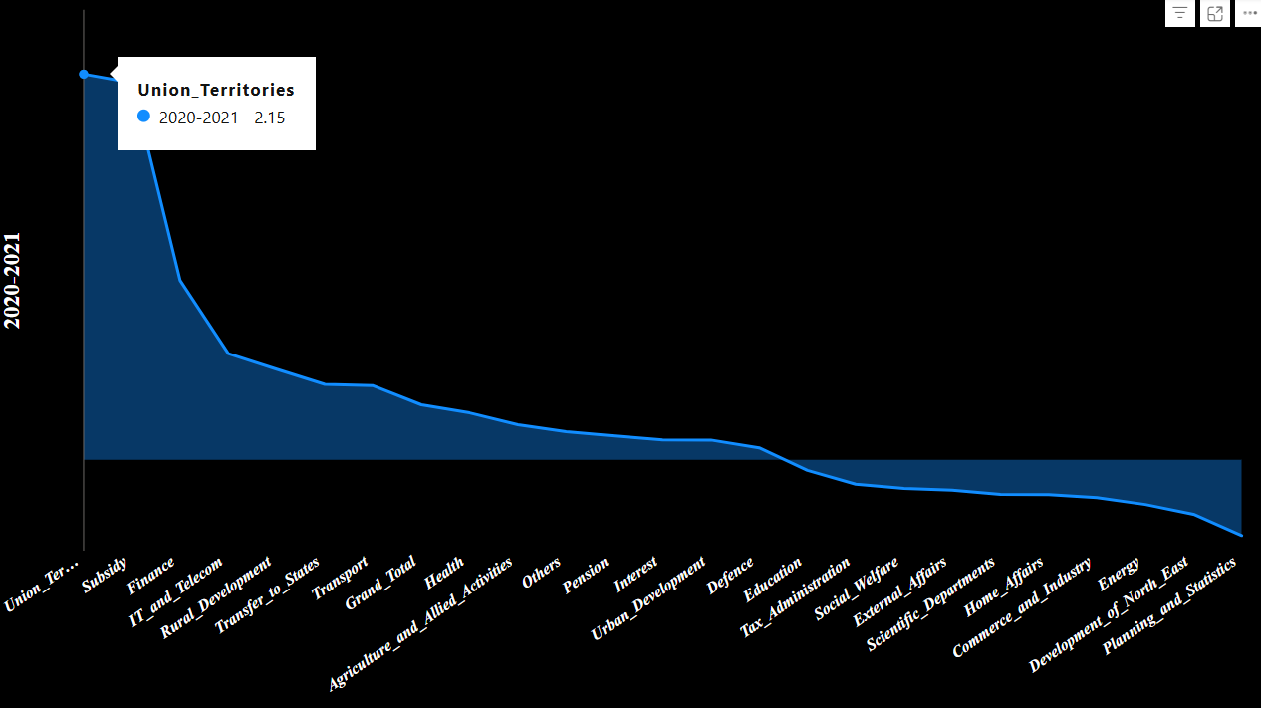
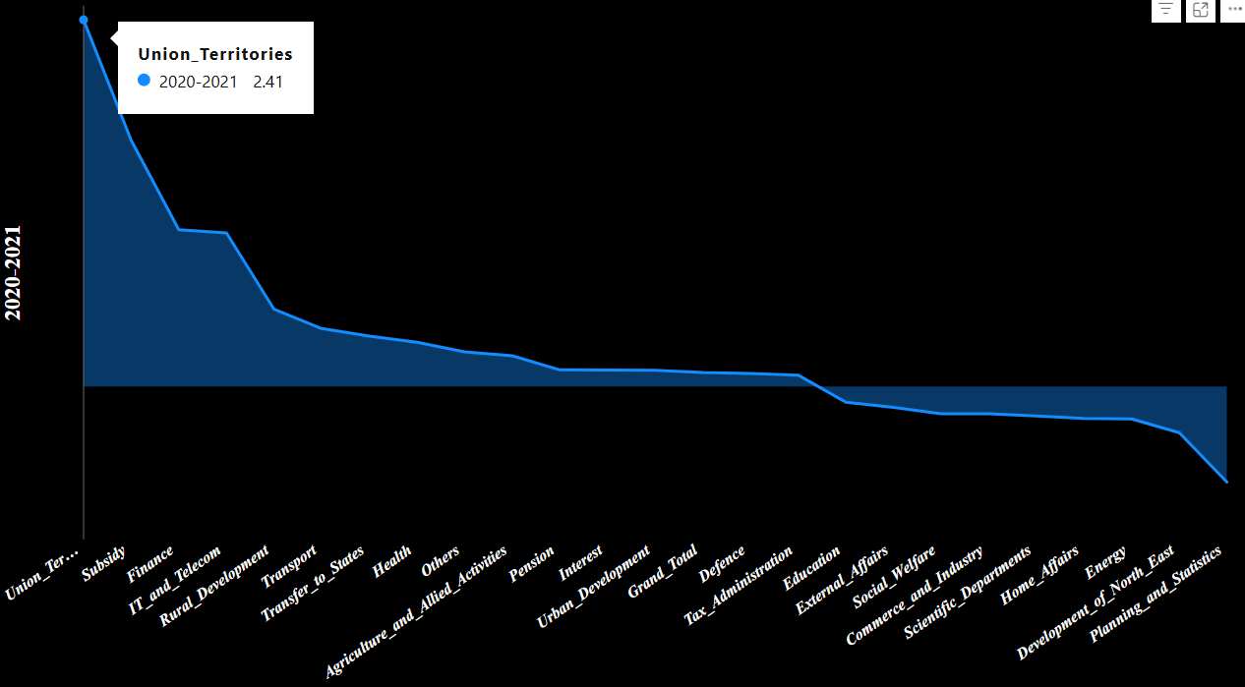
One of the most significant changes in India’s political landscape in 2019 was the abrogation of Article 370, which granted special status to Jammu and Kashmir. This decision led to the reorganization of J&K into two Union Territories: Jammu & Kashmir (with a legislative assembly) and Ladakh (without a legislative assembly).
The 2020 budget focused on subsidies primarily as a response to the economic crisis caused by the COVID-19 pandemic. The government sought to provide relief to the poor and vulnerable by enhancing food, energy, and agricultural subsidies, alongside expanding social welfare schemes.
Actuals
Estimates
SECTOR TREND ANALYSIS

Slide 21
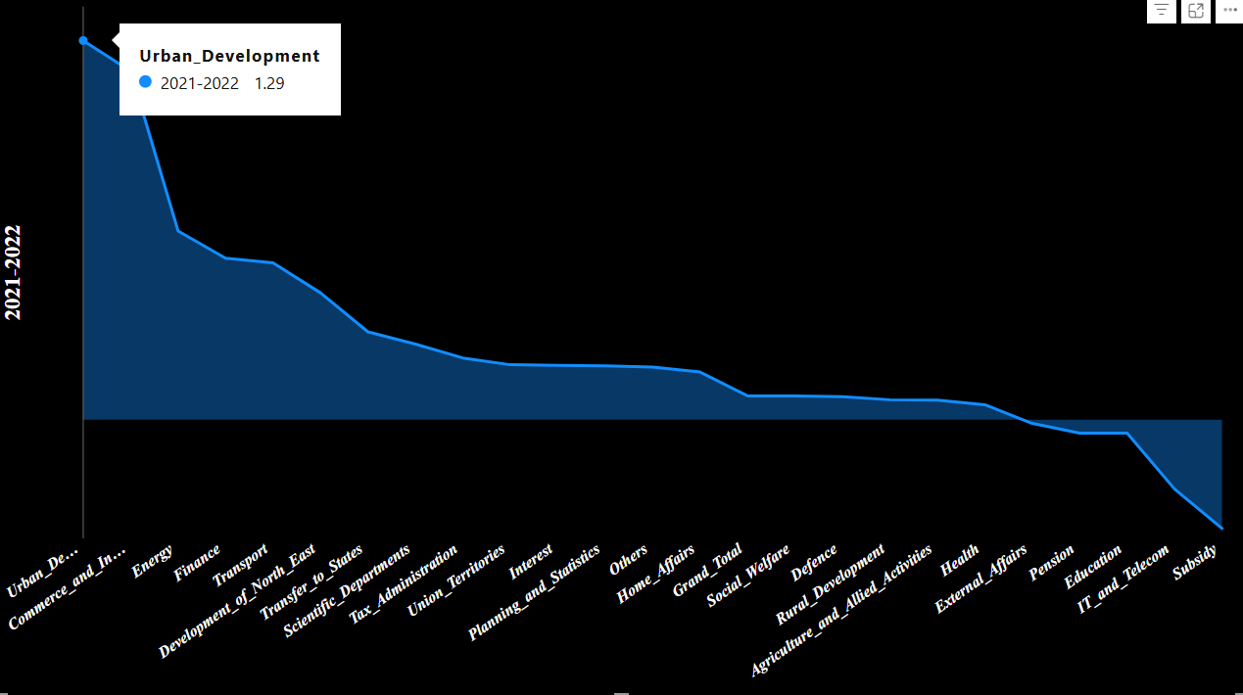
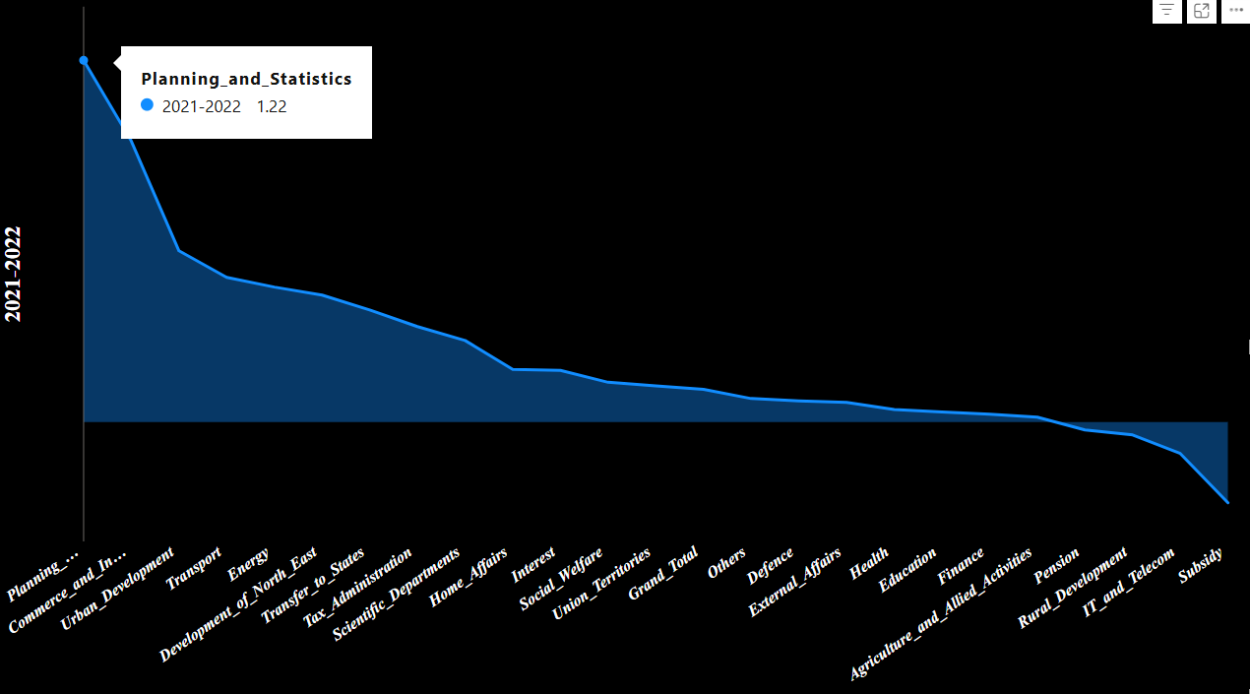
The reason why the Indian government in 2021 ended up spending more on Urban Development than initially estimated for Planning and Statistics can largely be attributed to the post-pandemic recovery of urban centers, the increased need for infrastructure, and the urgent challenges faced by cities during the pandemic. While planning and statistics are essential for long-term growth, urban development was seen as an immediate priority for the economic recovery, public health, and social stability of urban areas, which required substantial financial resources. Therefore, the shift in expenditure priorities reflected the government's response to pressing urban needs and a focus on rebuilding and modernizing cities to support future growth.
Actuals
Estimates

Slide 22
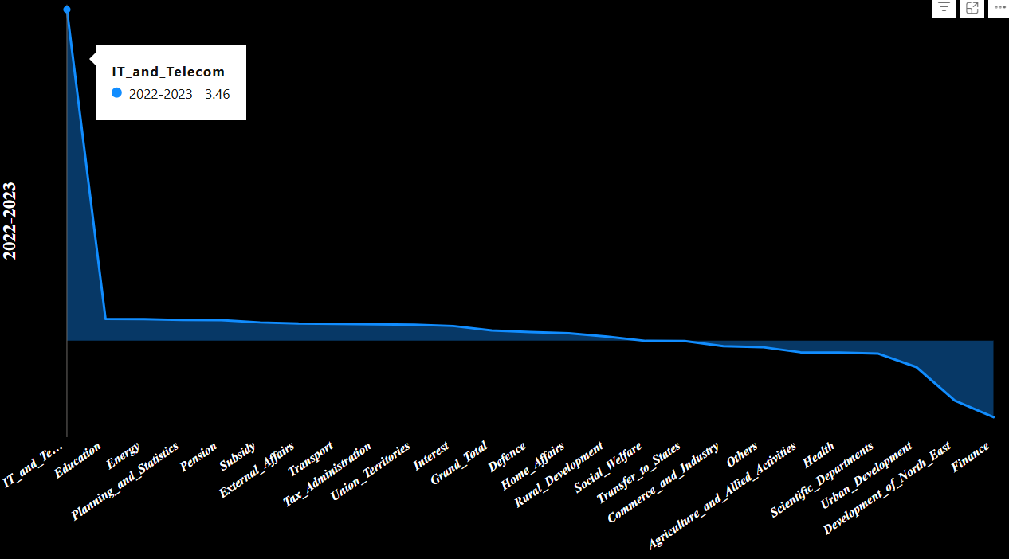
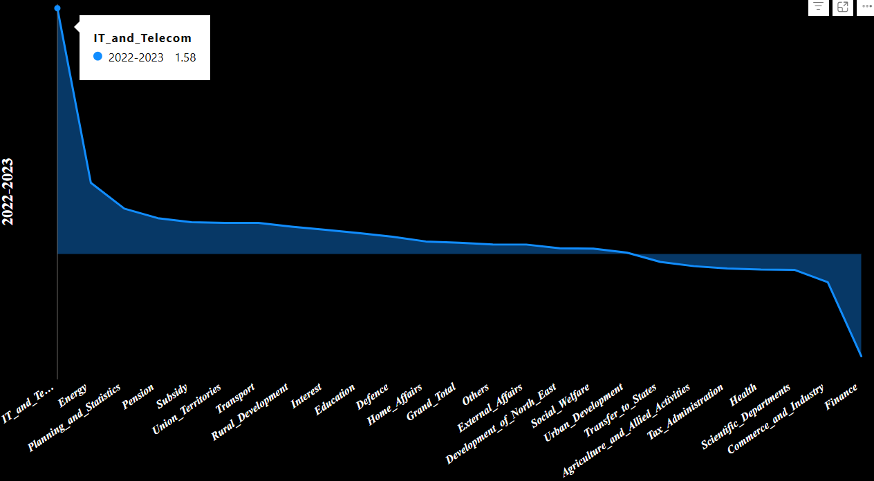
The post-pandemic need for digital education infrastructure, including online learning platforms, teacher training, and digital tools, which led the government to prioritize education.
The ongoing Digital India initiative (5G Rollout), which continued to drive investments in IT and telecom infrastructure to ensure digital connectivity and support economic growth.
The government’s focus on addressing skills gaps and developing a future-ready workforce through education, particularly in digital and technical fields, in line with long-term economic recovery goals.
Actuals
Estimates

Slide 23
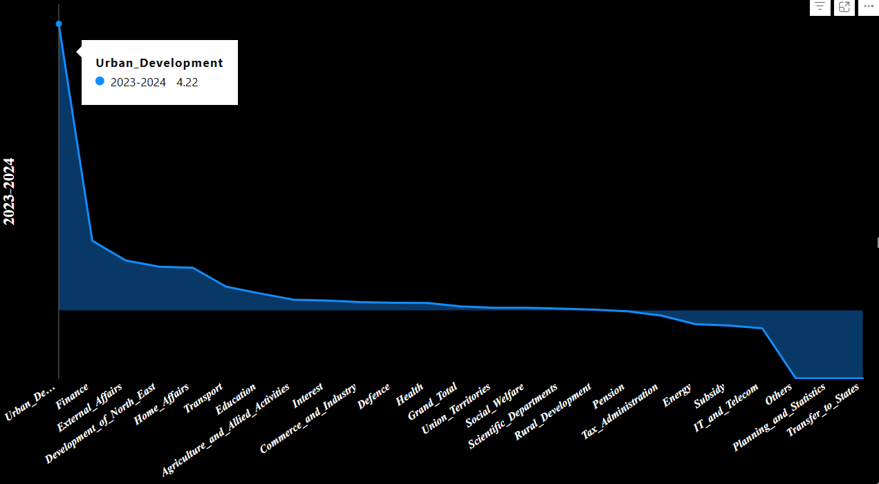
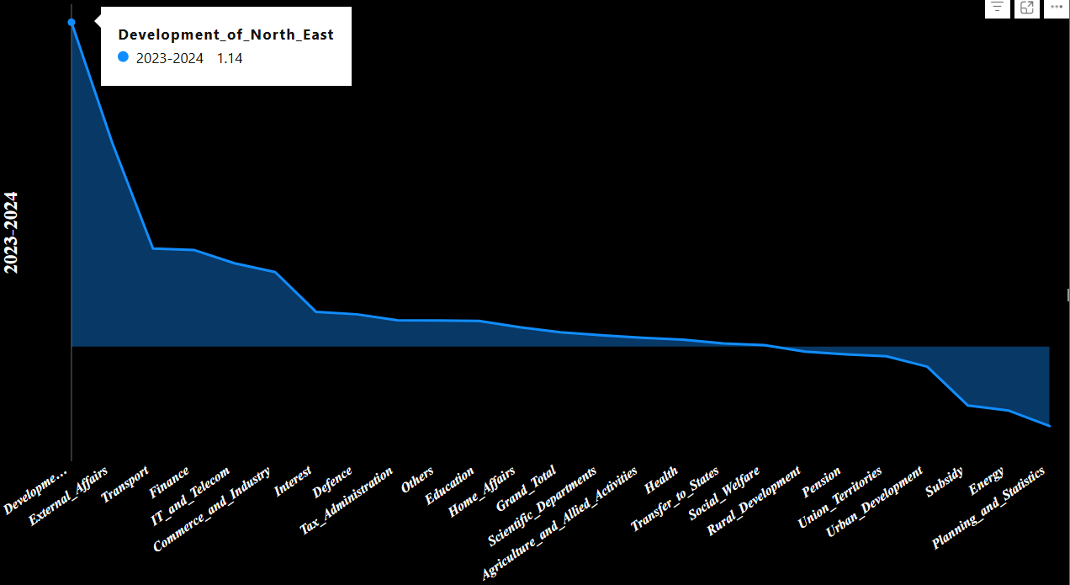
The post-pandemic recovery of urban areas and the need for urgent infrastructure development in cities.
The strategic importance of ensuring financial stability and providing fiscal reforms to support the overall economy.
The government's focus on improving urban infrastructure, housing, and mobility to address challenges in rapidly urbanizing areas.
Political considerations and electoral priorities might have also played a role in directing more resources toward urban development.
Actuals
Estimates
SECTOR TREND ANALYSIS

Slide 24

SECTOR
PRIORTIZATION

Slide 25
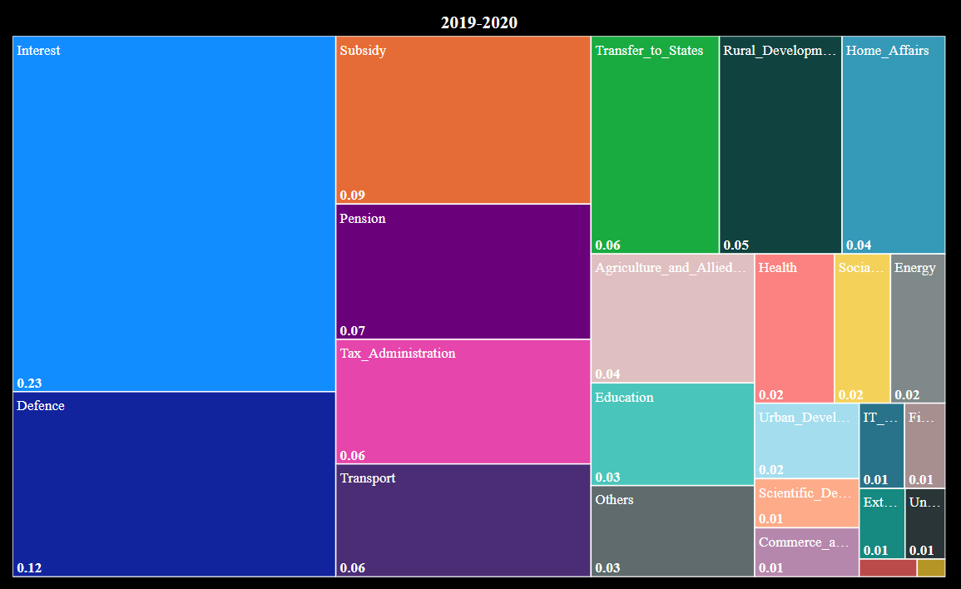
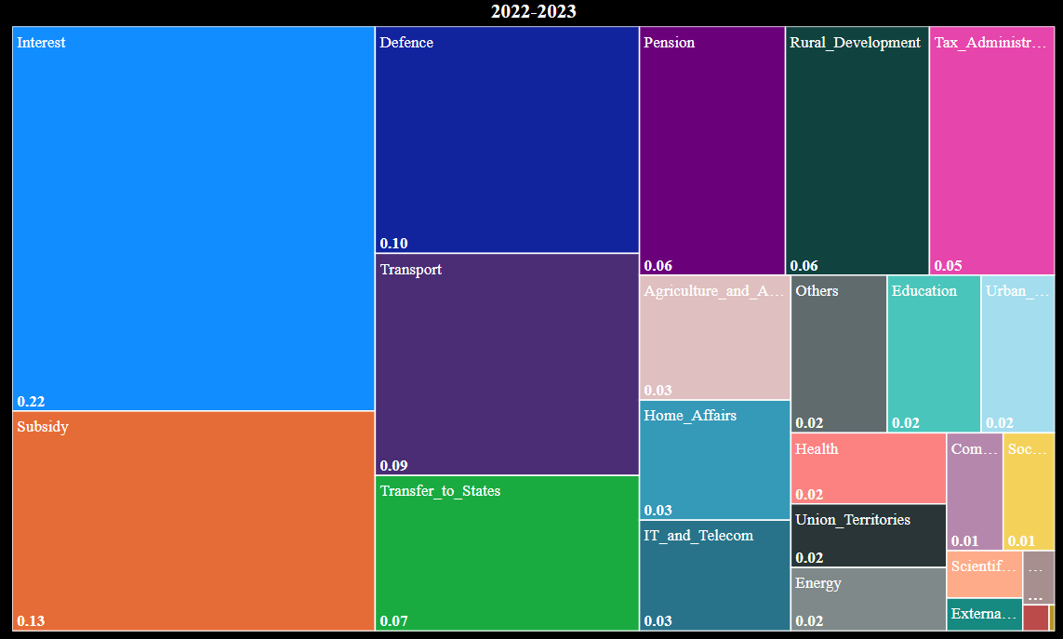
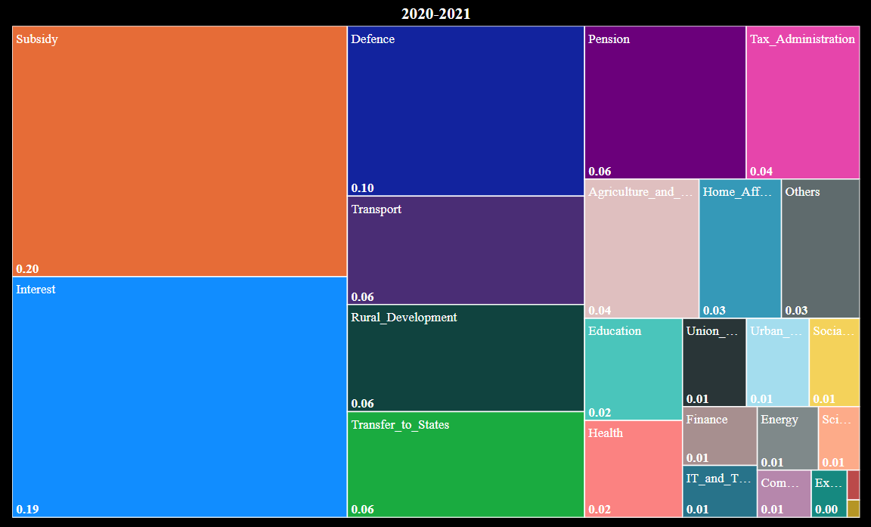
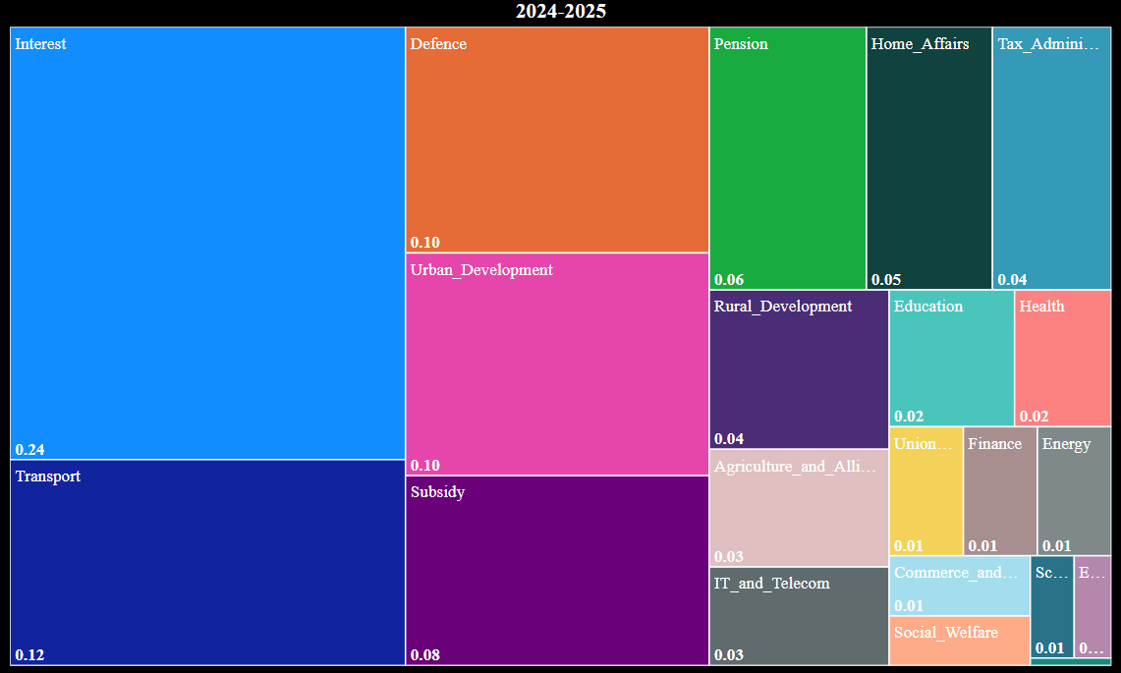
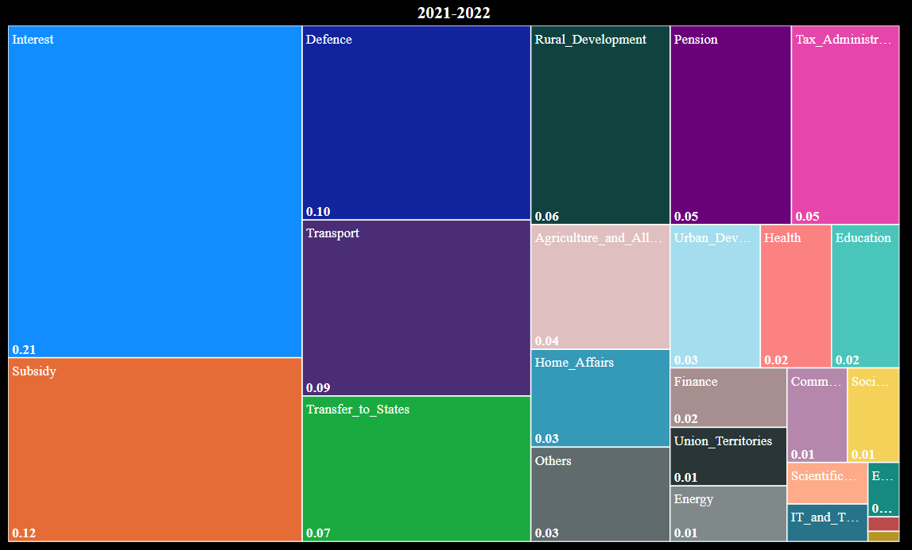
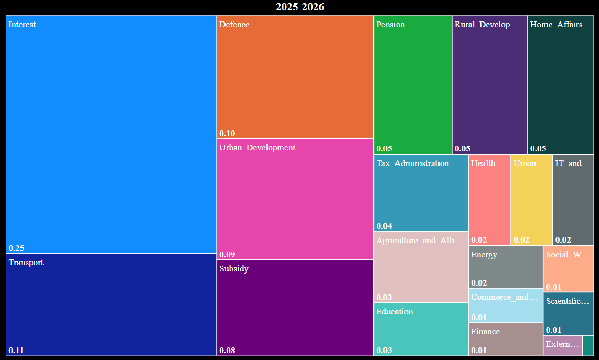
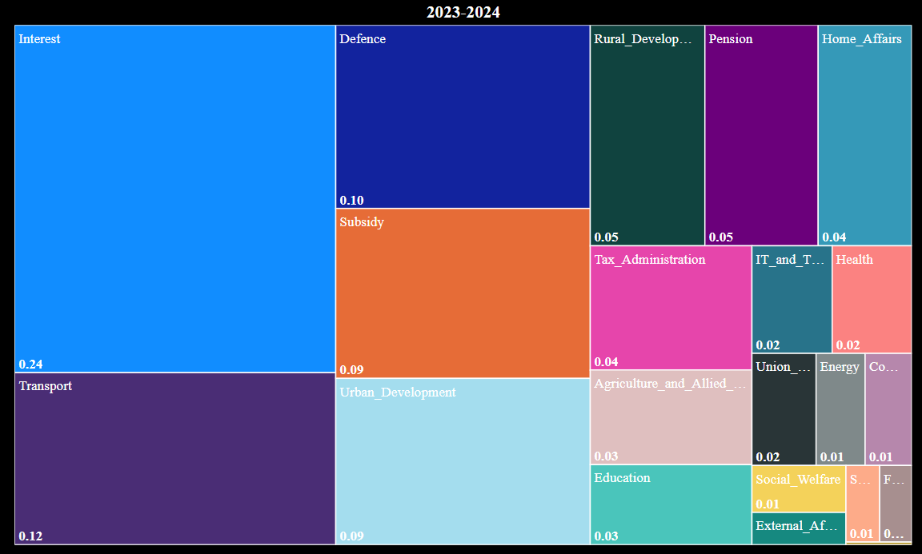
2022-2023
2019-2020
2023-2024
2020-2021
2024-2025
2021-2022
2025-2026
SECTOR
PRIORTIZATION

Slide 26
2019-2020
2020-2021
2021-2022
2022-2023
2023-2024
2024-2025
Geopolitical Concerns and National Security: In 2019, India faced increasing geopolitical tensions, particularly with its neighboring country, Pakistan, and ongoing challenges with China along the LAC (Line of Actual Control).
Political Considerations: The 2019 Budget came ahead of general elections. As national security was a critical topic in the political discourse, particularly after incidents like the Pulwama attack (2019) and the subsequent Balakot airstrike, defense spending and focus were elevated as a matter of national priority.
2025-2026
SECTOR
PRIORTIZATION

Slide 27
2020-2021
2019-2020
2021-2022
2022-2023
2023-2024
2024-2025
2025-2026
SECTOR
PRIORTIZATION

Slide 28
2021-2022
2019-2020
2020-2021
2022-2023
2023-2024
2024-2025
2025-2026
SECTOR
PRIORTIZATION

Slide 29
2022-2023
2019-2020
2020-2021
2021-2022
2023-2024
2024-2025
Green and sustainable transport, especially electric vehicles, as part of India’s environmental and climate goals.
2025-2026
SECTOR
PRIORTIZATION

Slide 30
2023-2024
2019-2020
2020-2021
2021-2022
2022-2023
2024-2025
2025-2026
SECTOR
PRIORTIZATION

Slide 31
2024-2025
2019-2020
2020-2021
2021-2022
2022-2023
2023-2024
The government’s 2024 focus on transport included a push for expanding metro networks, improving public transportation, and implementing smart mobility solutions to address traffic congestion, pollution, and the need for better urban transport.
Bharatmala Project: The Bharatmala Pariyojana, a long-term initiative to develop highways and roads, continued to receive attention in 2024.
2025-2026
SECTOR
PRIORTIZATION

Slide 32
2025-2026
2019-2020
2020-2021
2021-2022
2022-2023
2023-2024
2024-2025
SECTOR
PRIORTIZATION

Slide 33
SECTOR ANALYSIS

Slide 34
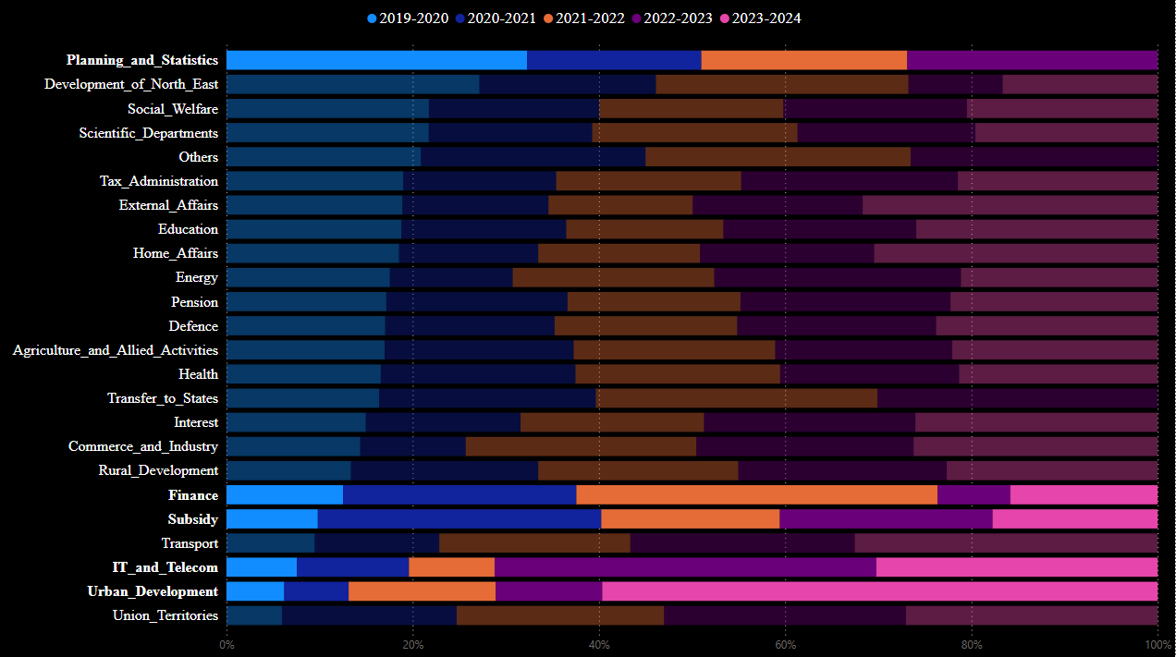
SECTOR ANALYSIS
Accelerated digital transformation in response to the pandemic and increased reliance on remote services like work from home, digital education, and telemedicine.
Focus on broadband expansion, especially in rural areas, and upgrades to 4G and 5G infrastructure.
Post-Demonetization Impact: After the demonetization policy in 2016, the government may have used the year 2019 to assess the long-term economic consequences and to plan for a recovery phase. This would have involved extensive planning and analysis, requiring statistical evaluations to assess how different sectors were recovering and what interventions were necessary.
Election Year Preparation (2020): Given that the general elections were held in 2019, the government may have focused on economic and social data analysis to evaluate progress in different sectors and prepare for electoral promises. The expenditure in Planning and Statistics could have been aimed at creating data reports and indicators that highlighted the success of government programs and facilitated the political discourse ahead of the elections.
Overall, the government’s focus on subsidies in 2020 was a direct response to the pandemic's economic fallout, and these interventions were critical in ensuring economic stability, addressing health crises, and maintaining social welfare during an exceptionally challenging year.
The significant contribution in the Urban Development sector in 2023 reflects the government's commitment to building modern, sustainable, and livable cities while addressing the challenges of rapid urbanization and improving the quality of life for urban populations.
Stimulus and economic recovery packages: Allocating funds for subsidized loans, interest subsidies, and credit guarantees to support businesses and industries.
Increased borrowing and fiscal management: Funding essential welfare schemes and stimulus programs through government borrowing and debt management.
Social welfare programs: Ensuring continuous support through direct transfers, food subsidies, and healthcare expenditures.
Healthcare funding: Massive allocations to the COVID-19 vaccination drive and medical infrastructure.
Energy and fuel subsidies: Managing fuel price stabilization and ensuring energy affordability for the population.
Tax and revenue mobilization: Focusing on tax reforms and improving revenue generation to support increased expenditures.

Slide 35

FISCAL DEFICIT
TREND

Slide 36
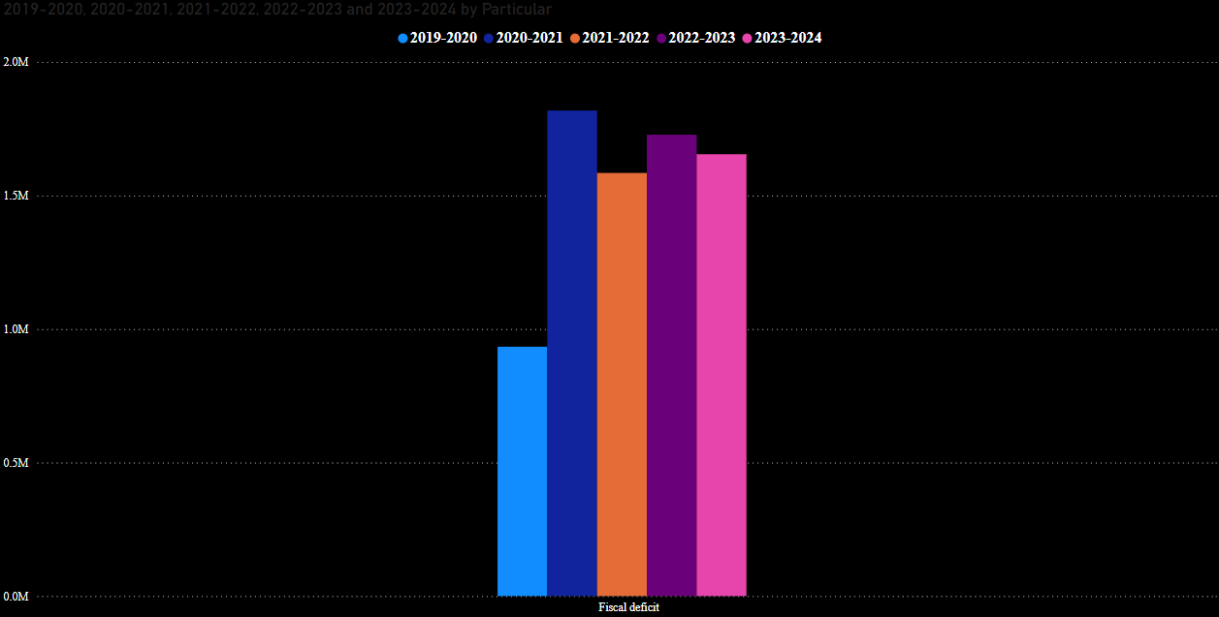
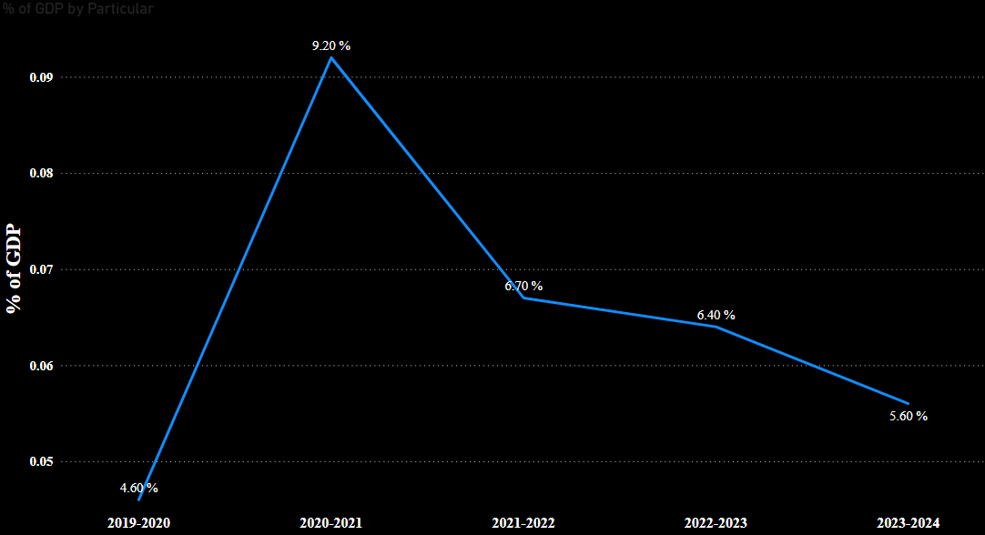
A high fiscal deficit as a percentage of GDP means the government is borrowing a larger portion of its economic output. This could increase national debt levels.
If this ratio is high, it could indicate that the government is heavily dependent on borrowing, which might not be sustainable in the long run.
A lower percentage suggests that the government is keeping its spending in check relative to the economy's total size. It is more likely to be financially stable and less reliant on external debt.
5.60% (2023): This means that the government’s fiscal deficit is 5% of the country’s total economic output. The government is borrowing an amount equivalent to 5% of GDP to finance its expenditure beyond its revenue.
FISCAL DEFICIT
TREND

